Slide 1
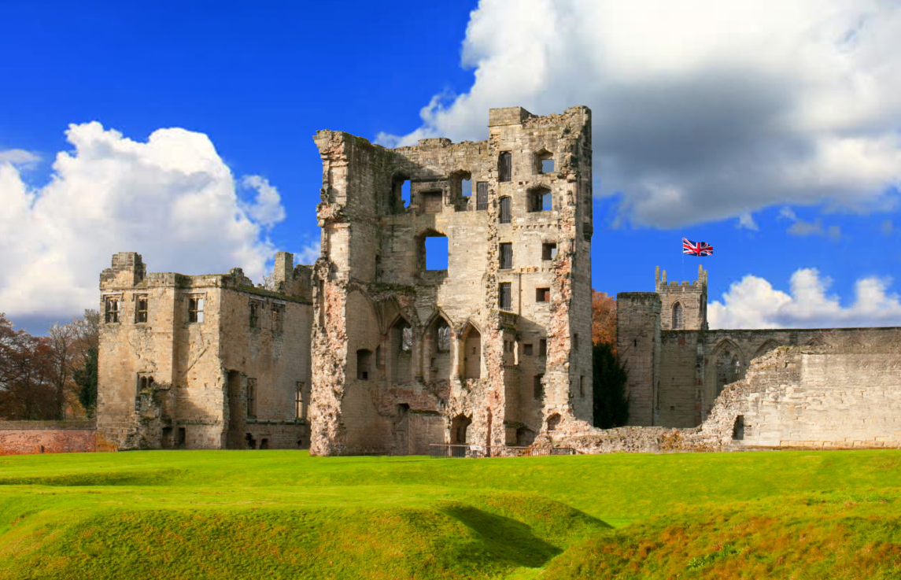
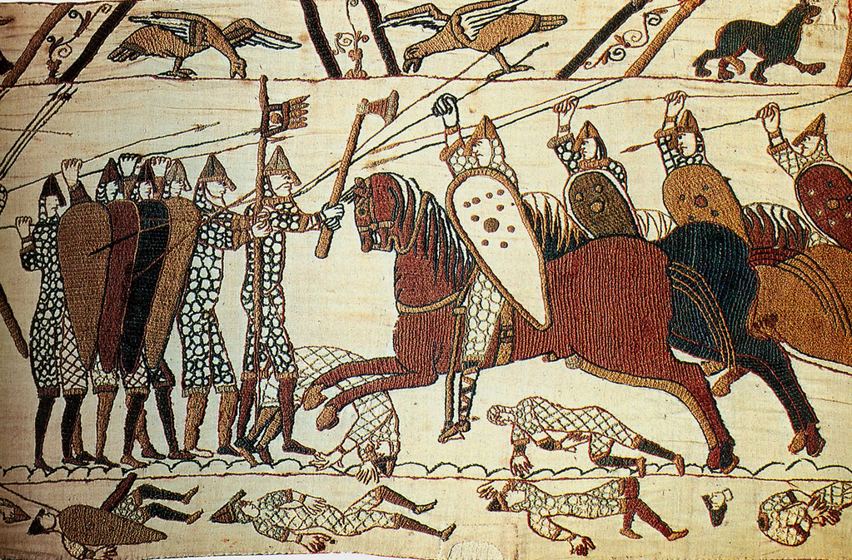
William Pidzamecky
CENTRE FOR MEDIEVAL RESEARCH
William Pidzamecky
RESEARCH SEMINARS
Autumn Term 2023–24
The University of Leicester Centre for Medieval Research is pleased to announce this Autumn Term’s schedule of Tuesday Research Seminars. These Research Seminars are fora for discussing new research, research ideas and current debates in the field of medieval studies, whether historical, art historical, architectural, archaeological, literary or numismatic, from AD 500–1550. This block of talks has the theme of ‘War, conflict, martial display and defence’:
24 October – xxx
7 November – Frontier? Who Says? (Early) Medieval Classifications and Exploitations of Frontier Spaces in Iberia and Elsewhere. Dr Jonathan Jarrett (School of History, University of Leeds)
14 November – Warhorse. A Medieval Revolution? Equestrian Landscapes, Material Culture and Zooarchaeology in Britain, AD800-1600. Prof Oliver Creighton (Dept of Archaeology, University of Exeter)
21 November – Appetite for Destruction? The Role of Castle Slighting in the Middle Ages.
Dr Richard Nevell (Dept of Archaeology, University of Exeter; Wikipedia)
28 November – Musical Warfare: Crusade Songs and Arabic anti-Frankish Poetry. Kate Arnold (Nottingham Trent University); Writing War and Conflict in Historical Fiction, James Aitcheson (Department of Culture and Media, Sheffield Hallam University)
5 December – Kings, Conflict and Peacemaking in Medieval Norway. Harriet Clark; Longphuirt, Wintersetlu, and Gorodišče: A Comparison of Viking Overwintering Sites, William Pidzamecky (both M4C; Centre for the Study of the Viking Age, University of Nottingham)
12 December – tbc
Left: Ashby-de-la-Zouch castle, Leicestershire. Right: War on foot and horse as depicted on the Bayeaux Tapestry
Time: 5.00-6.00 pm. Venue: Bennett Lecture Theatre 3.
Microsoft Teams access - Click here to join the meeting
Contact: njc10@le.ac.uk https://www2.le.ac.uk/departments/mrc

